Slide 1
Secure data hiding in images using steganography
CAPSTONE PROJECT
Presented By: AKSHAYAA G
Student Name : AKSHAYAA G
College Name & Department : Loyola-ICAM College of Engineering and Technology / Information Technology

Slide 2
OUTLINE
Problem Statement
Technology used
Wow factor
End users
Result
Conclusion
Git-hub Link
Future scope

Slide 3
Problem Statement
The persistent risk of interception and unauthorised access exists for sensitive data sent over digital networks. Although encryption successfully protects data, it also makes concealed information visible, which may draw unwanted attacks. The likelihood of targeted breaches, in which hackers deliberately try to decode or alter the secured data, may rise as a result of this visibility. Therefore, there is an urgent need for a technique that hides the existence of the buried data itself in addition to ensuring confidentiality through encryption. By adding an extra layer of security, such a method would make it much more difficult for attackers to find, intercept, or breach sensitive data.

Slide 4
Technology used
Platform: Python IDLE
Libraries:
OpenCV: For image processing and manipulation.
NumPy: For handling and manipulating image arrays.
PIL (Pillow): For image handling and operations.
Cryptography: For encrypting and securing the hidden messages.

Slide 5
Wow factors
Layered Security: Combines hidden communications and encryption to provide better security. Historical Significance: Since ancient times, steganography has been employed in espionage during times of conflict. Current Applications: Used in a number of domains, including copyright protection and digital forensics. Hidden in Plain Sight: Images can include embedded messages without causing obvious changes. Power of Open Source: Programs such as OpenCV enable effective and accessible image processing.

Slide 6
End users
Individuals: Preserving confidentiality in private correspondence. Journalists & Whistleblowers: Securely sharing sensitive information. Companies: Preserving intellectual property and private information. Governmental Organisations: Preserving national interests and guaranteeing safe communication. Experts in digital forensics: looking into cybercrimes and keeping track of digital evidence.

Slide 7
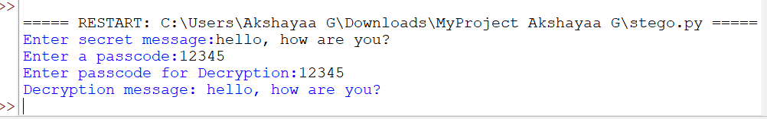
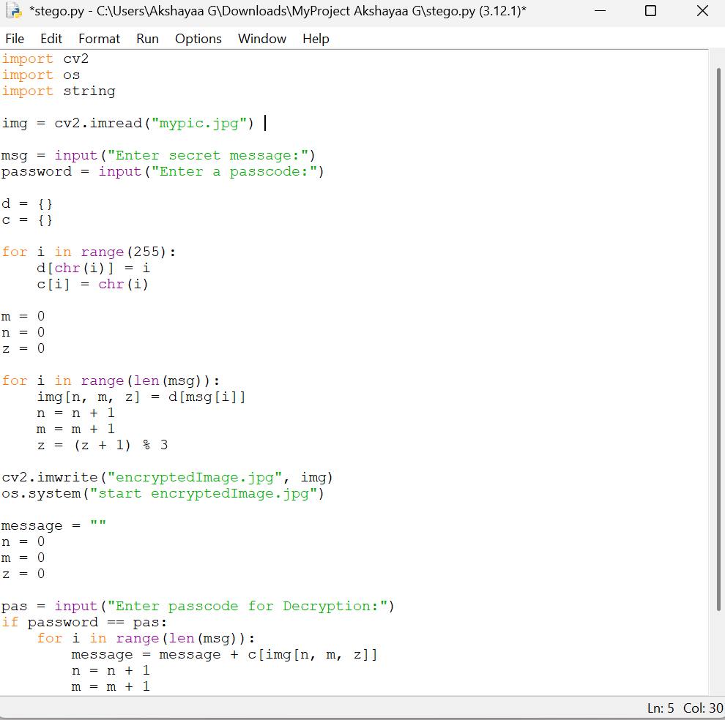

Results

Slide 8
Conclusion
The effective use of steganography to safely embed and retrieve concealed messages within digital photos is investigated in this study. We guarantee that private information can be subtly hidden without compromising the image's aesthetic integrity by utilising Python and sophisticated image-processing packages like OpenCV, NumPy, and PIL. When this method is used, it makes it possible to communicate covertly, guaranteeing that private information can be safely sent while avoiding detection by unauthorised parties. This method greatly improves data security and privacy, making it a useful tool in a variety of fields, such as business data security, governmental intelligence operations, and protecting individual privacy. Furthermore, by combining steganography and encryption, this technique improves the resilience and confidentiality of digital communication while offering a strong defence against illegal access and cyberthreats.

Slide 9
GitHub Link
https://github.com/Akshayaa08/Steganography

Slide 10
Future scope(optional)
Advanced cybersecurity includes tamper-proof protection with blockchain integration and AI-driven anti-detection techniques. AI-Powered Steganography: Deep learning-based methods for real-time encoding and undetected data concealing. Covert communication for espionage and military operations is part of defence and intelligence. Digital watermarking: Safe copyright defence and document and media tamper detection. IoT and cloud security: concealed data transfer in smart devices and safe cloud storage. Quantum Steganography: Quantum-resistant methods for safe key distribution and unbreakable encryption.

Slide 11
THANK YOU

